Slide 1
Insert Pitiful Mission Name
Michael Ganger, Heidi Kroening, Andrew Redman

Slide 4
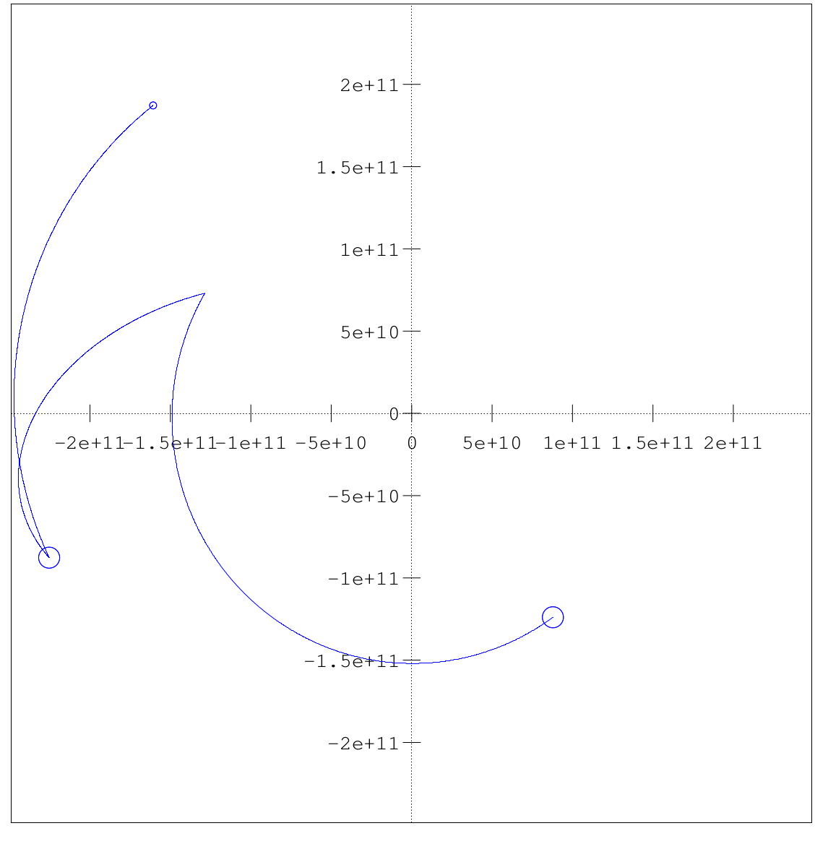
Path to Mars

Slide 5
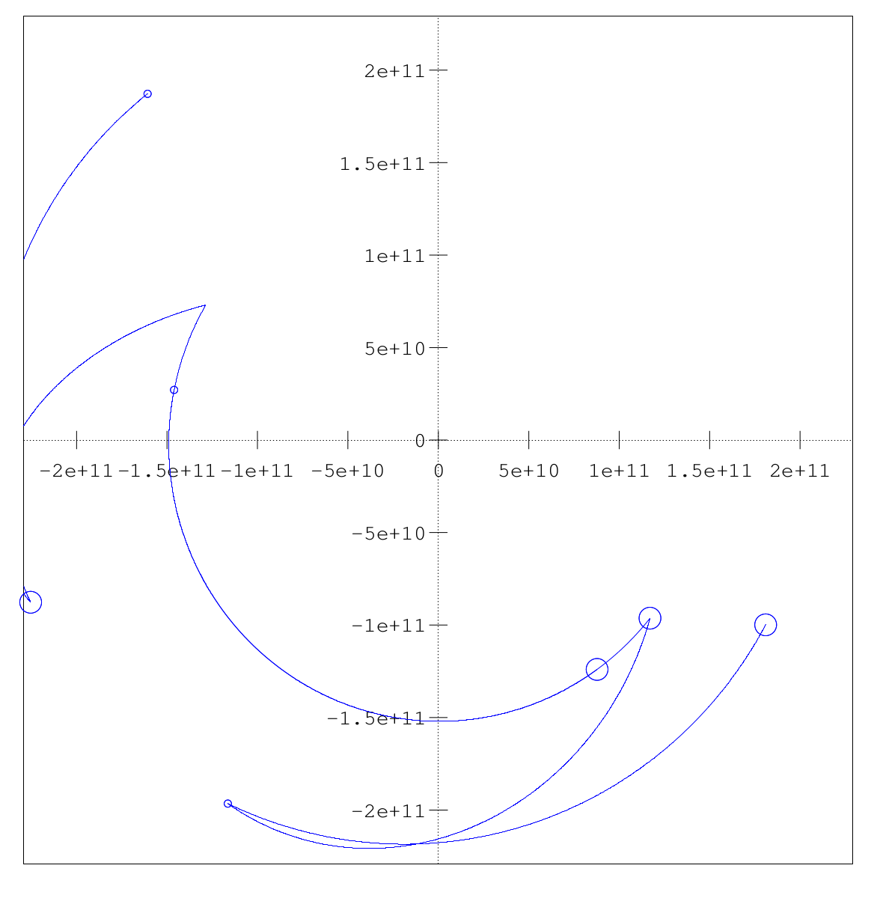
Return trip from Mars

Slide 6
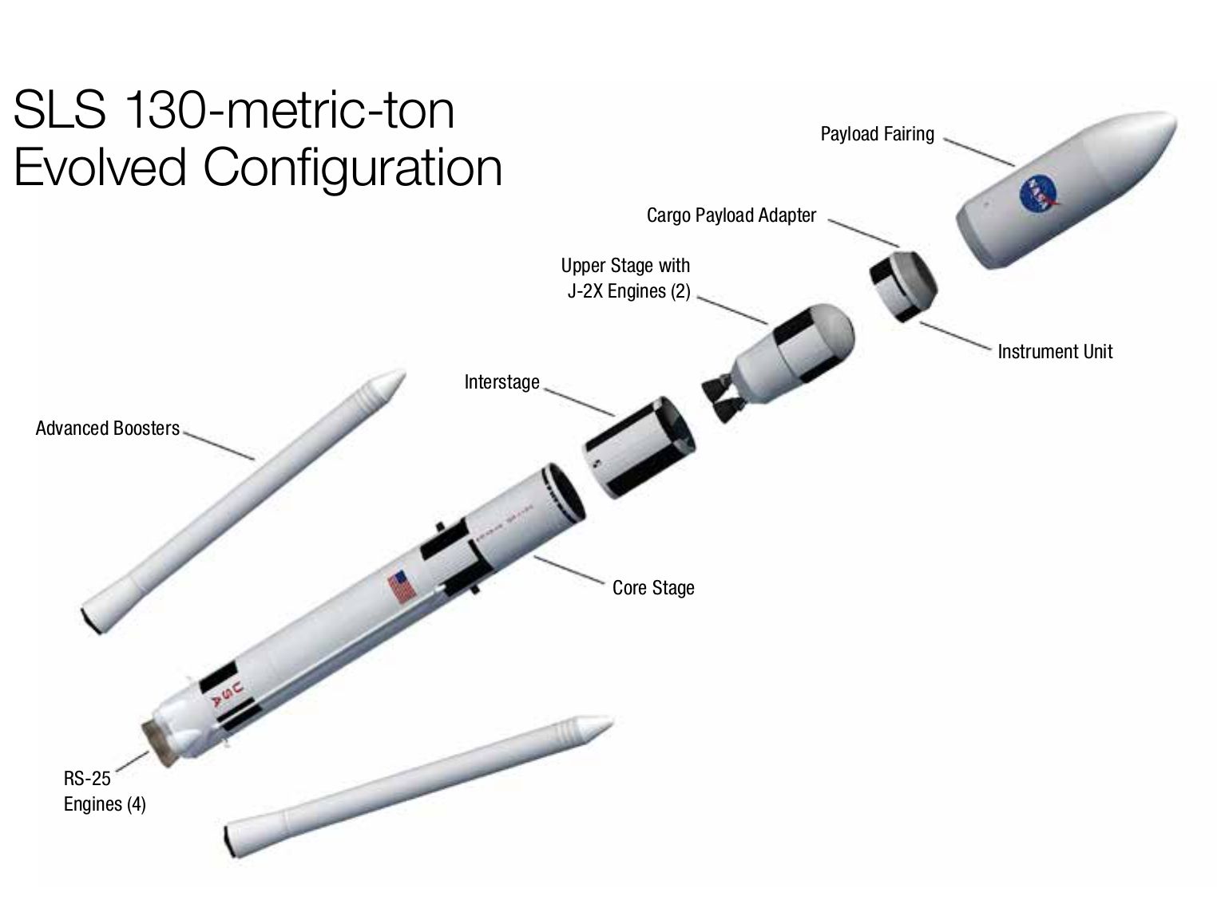
Space Launch System
http://www.nasa.gov/pdf/664158main_sls_fs_master.pdf

Slide 7
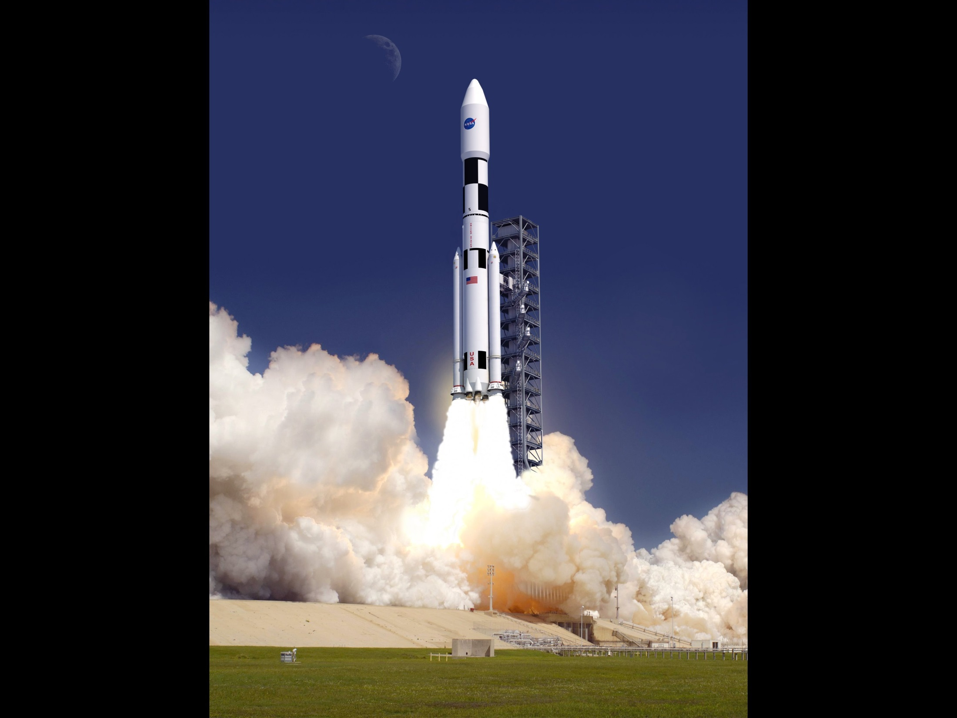
Mass: 2 950 000 kg
Height: 117 m
Max Payload: 130 000 kg
Thrust: 41 000 000 N

Slide 8
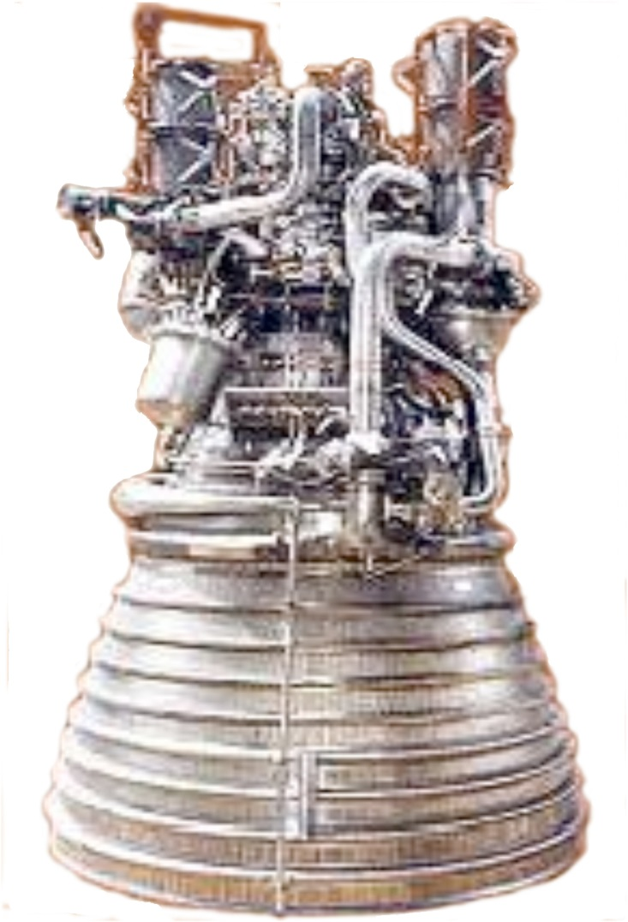
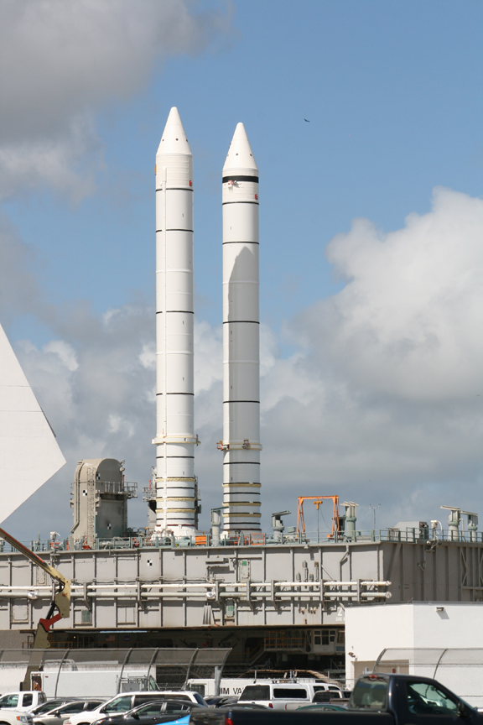
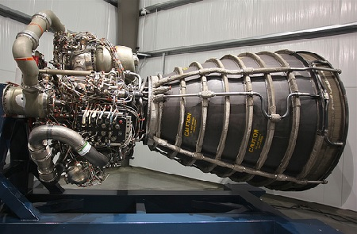
Solid Rocket Boosters
Isp: 269s
RS-25
Isp: 452s
http://exploration.grc.nasa.gov/print/LaunchVehicle_prt.htm
J-2X
Isp: 448s
http://spaceref.com/onorbit/stacked-shuttle-solid-rocket-boosters-on-the-move.html
http://techgenmag.com/2014/07/21/rs-25-engine/

Slide 9
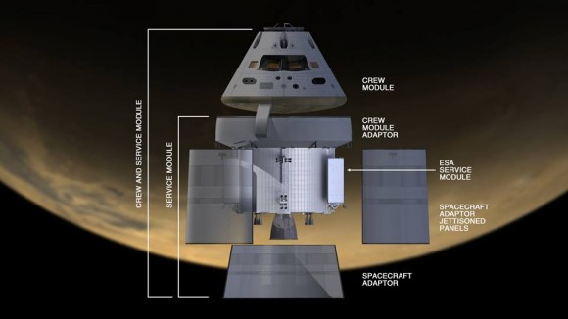
Orion
http://www.universetoday.com/107564/nasa-pressing-towards-fall-2014-orion-test-flight-service-module-complete/

Slide 10
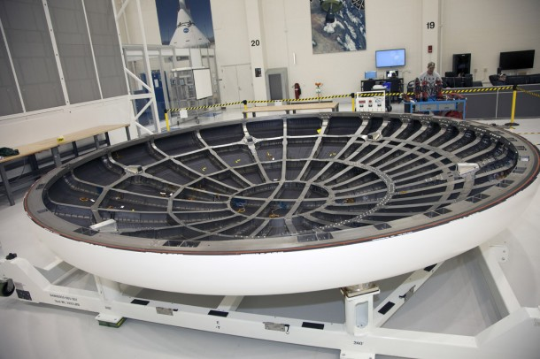
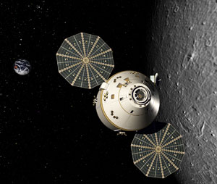
Heat Shielding
Outersurface: Avcoat
Generates surface temp of 6000° F
Max surface temp 3000° F
Backshell: AETB-8 tiles
Protection from excessive reentry heat and debris
http://www.spacefellowship.com/news/art36556/work-on-nasa-s-new-orion-spacecraft-progresses-as-engineers-pivot-to-2014.html
Radiation
Maximize material already on board
Introduction of Tesseract
Combination of metals to block gamma rays
UltraFlex solar array
Electrical power for life support
Propulsion and communications systems
6000 watts of power
Rechargeable lithium-ion batteries
Power
http://www.spaceravel.com/reports/ATK_To_Design_And_Build_Solar_Arrays_For_NASA_Orion_CEV_999.html

Slide 11
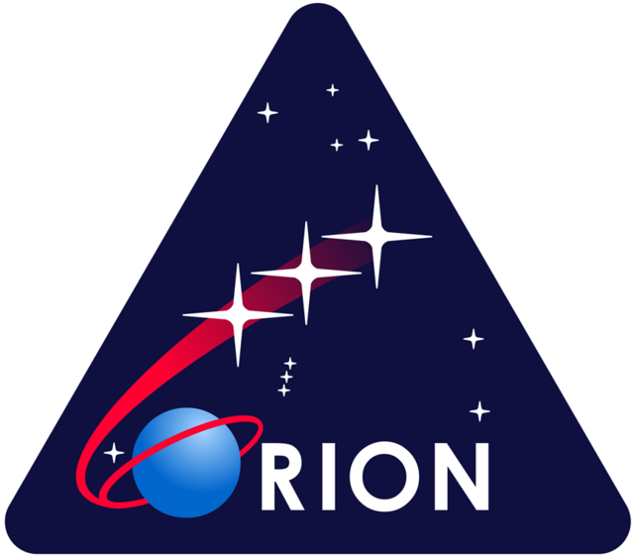
Life Support
Air
Regeneration:
CO₂ collected and broken down
Produces water and methane
Water → oxygen and hydrogen
Water
Fuel cells:
Generates drinkable water
Recycling:
Generates drinkable and washable water
Nutrition
Male: 708g
Female: 566g
Total Food: 1982g * 346
= 686 kg
http://microgravity.grc.nasa.gov/print/orion_prt.htm

Slide 12
Costs
Commercial launch: $500 million
SLS Rocket and Orion: $10 billion
Launch Pad and Kennedy Space Centre Upkeep: $2 billion
Fuel:

Slide 13
Bibliography
Kyle, Ed. "NASA's Space Launch System." Space Launch Report. 2014. Web. 2014.
"Life Support: Air, Water, and Nutrition." Mission 2004: Team Ten. Massachusetts Institute of Technology, 2000. Web. 2014.
NASA. "Food For Space Flight." HumanSpaceFlight. National Aeronautics and Space Administration, n.d. Web. 2014.
NASA. “Orion: America's Next Generation Spacecraft.” www.nasa.gov. National Aeronautics and Space Administration. Web. 2014.
NASA. ”Space Launch System (SLS): Fun Facts.” www.nasa.gov. National Aeronautics and Space Administration. Web. 2014.
NASA. ”Space Launch System (SLS): NASA Facts”. www.nasa.gov. National Aeronautics and Space Administration. Web. 2014.
NASA. ”Types of Radiation in Space.” www.nasa.gov. National Aeronautics and Space Administration. Web. 2014.
Smith, Marcia. "New NASA Crew Transportation System to Cost $18 Billion Through 2017." Spacepolicyonline.com. Space and Technology Policy Group, 2011. Web. 2014.
Wasserman, Shawn. "Orion Spacecraft Will Carry Radiation Shield Designed by High School Students." Engineering.com. 2014. Web. 2014.
Wall, Mike. "NASA's Huge New Rocket May Cost $500 Million per Launch."Msnbc.com. Space.com, 2012. Web. 2014.

